Slide 1


INTRODUCTION TO DATA SCIENCE UNVEILLING THE POWER OF DATA
Presented to
Mr.sNima Jhaa
Presented by
Anamika Gupta
B.Cs DATA SCIENCE
SEM(1)

Slide 2

content
Understanding data science
Foundations of data science
Practical application of data Science
Career opportunities in data science

Slide 3

Understanding data science

Slide 4
What is Data Science?
01
Data Analysis and Prediction
Data Science involves analyzing data to identify patterns and make predictions for the future.
Business Applications
Companies use Data Science to make informed decisions, optimize processes, and gaining the best result .
Data science is a multidisciplinary field that uses scientific methods, processes, algorithms, and systems to extract insights and knowledge from structured and unstructured data. It combines expertise from various domains, including statistics, computer science, mathematics, and domain-specific knowledge, to analyze and interpret complex data sets.

Slide 5

Key Concepts in Data Science
Probability and Statistics
Data Science relies on probability and statistics to draw meaningful insights from data.
Data Visualization
Visualizing data helps in understanding trends, patterns, and relationships within the data.
Machine Learning
Machine learning algorithms enable computers to learn from data and make predictions or decisions.

Slide 6

The Role of Data Scientists
01
Data Analysis
Data scientists are responsible for analyzing complex data sets.
02
Programming and Tools
Proficiency in programming languages like Python and R, as well as tools like SQL and Tableau, is essential for data scientists.
03
Communication Skills
Data scientists need to effectively communicate their findings and insights to non-technical stakeholders.

Slide 7
Foundations of Data Science

Slide 8
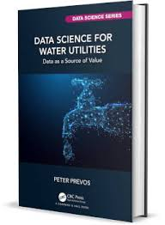
SWOT Analysis of Data Science
Strength
Data Science empowers organizations to make data-driven decisions, leading to improved efficiency and innovation.
Weakness
Data Science requires a deep understanding of statistical concepts and programming languages, posing a learning curve for beginners.
Opportunity
The increasing demand for data-driven insights creates numerous career opportunities for aspiring data scientists.
Threat
Inaccurate or biased data can lead to flawed analysis and incorrect predictions, impacting business decisions.

Slide 9
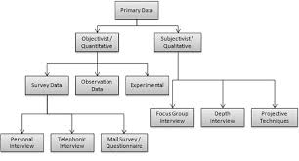
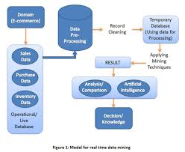
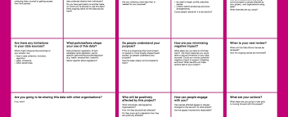
Data Collection and Cleaning
01
Data Collection Methods
Data scientists gather data from various sources, including databases, APIs, and web scraping.
02
Data Preprocessing
Cleaning and preprocessing data is crucial to ensure its quality and reliability for analysis.
03
Data Ethics
Ethical considerations in data collection and usage are essential to maintain integrity and trust.

Slide 10
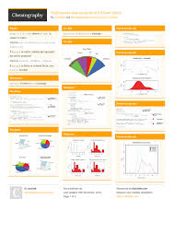
Exploratory Data Analysis (EDA
Data Exploration Techniques
EDA involves visualizing and summarizing data to understand its distribution and relationships.
Identifying Patterns
EDA helps in identifying patterns, anomalies, and trends within the data.
Hypothesis Testing
EDA supports hypothesis testing to validate assumptions and draw meaningful conclusions.

Slide 11
Statistical Modeling
03
Model Evaluation
Assessing the performance of statistical models through metrics like accuracy, precision, and recall.
01
Regression Analysis
Statistical models like linear regression help in understanding the relationship between variables.
02
Predictive Modeling
Building predictive models using algorithms like decision trees and random forests for future predictions.

Slide 12
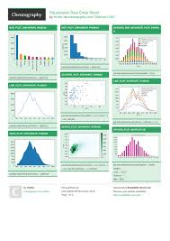
Data Visualization Techniques
Graphs and Charts
Visual representations like bar graphs, scatter plots, and heat maps aid in conveying insights from data.
Interactive Dashboards
Creating interactive dashboards using tools like Tableau or Power BI for dynamic data exploration.
Storytelling with Data
Using data visualization to tell compelling stories and communicate insights effectively.

Slide 13
Practical Applications of Data Science

Slide 14
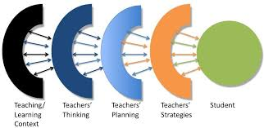


Business Intelligence and Analytics
01
Data-driven Decision Making
Data Science enables businesses to make strategic decisions based on data insights.
02
Market Analysis
Analyzing market trends, customer behavior, and competition to drive business growth and innovation.
03
Performance Monitoring
Tracking key performance indicators (KPIs) and metrics for business performance evaluation.

Slide 15
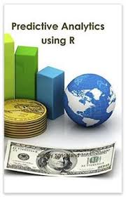
Predictive Analytics and Forecasting
Demand Forecasting
Predicting future demand for products or services based on historical data and market trends.
Risk Assessment
Using predictive analytics to assess and mitigate risks in financial, insurance, and healthcare sectors.
Churn Prediction
Identifying factors leading to customer churn and developing strategies to retain customers.

Slide 16
Healthcare and Medical Research
01
Clinical Data Analysis
Analyzing patient data to improve treatment outcomes and personalize healthcare interventions.
02
Drug Discovery
Using data science for drug development, identifying potential compounds, and optimizing clinical trials.
03
Epidemiological Studies
Analyzing population health data to understand disease patterns and public health interventions.

Slide 17
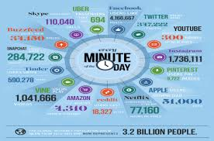
Data Science in Social Impact
Non-profit Organizations
Leveraging data science for fundraising, impact assessment, and program evaluation in non-profit sectors.
Disaster Response
Using data analysis to predict and respond to natural disasters, humanitarian crises, and public health emergencies.
Policy Making
Providing data-driven insights to policymakers for informed decision-making and social interventions.

Slide 18
Career Opportunities in Data Science

Slide 19
Data Science Roles and Skills
01
Data Analyst
Proficiency in SQL, Excel, and data visualization tools for analyzing and interpreting data.
02
Data Engineer
Skills in big data technologies, data warehousing, and ETL processes for data infrastructure.
03
Machine Learning Engineer
Expertise in machine learning algorithms, model development, and deployment.

Slide 20
Professional Development in Data Science
Certifications and Courses
Pursuing certifications and specialized courses in data science, machine learning, and big data technologies.
Practical Projects
Engaging in real-world projects and competitions to apply data science skills and build a portfolio.
Networking and Communities
Joining data science communities, attending meetups, and networking with professionals in the field.

Slide 21
Industry Demand and Growth
01
Job Market Trends
The increasing demand for data scientists across industries, including technology, finance, healthcare, and e-commerce.
02
Salary and Compensation
Competitive salaries and benefits for data science professionals due to the high demand and specialized skills.
03
Future Prospects
The continuous growth of data science and its applications, creating long-term career opportunities and growth potential.

Slide 22
Ethical Considerations in Data Science
01
Data Privacy and Security
Upholding data privacy laws and regulations to protect sensitive information.
02
Bias and Fairness
Addressing biases in data collection, model development, and decision-making processes.
03
Transparency and Accountability
Ensuring transparency in data practices and being accountable for the ethical use of data.

Slide 23
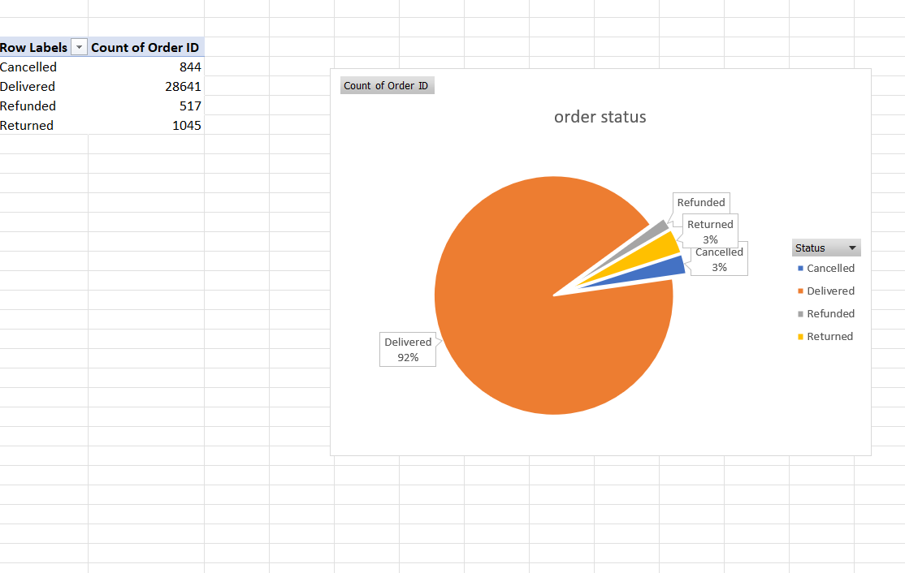
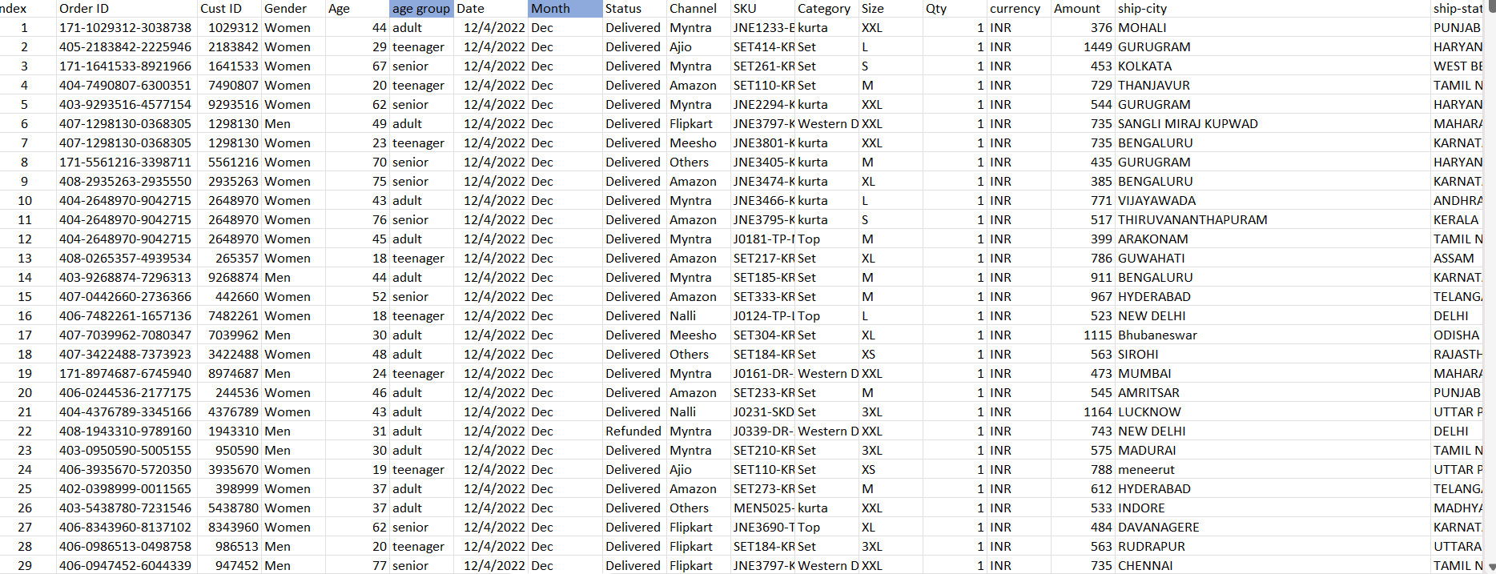
Dash board

Slide 24
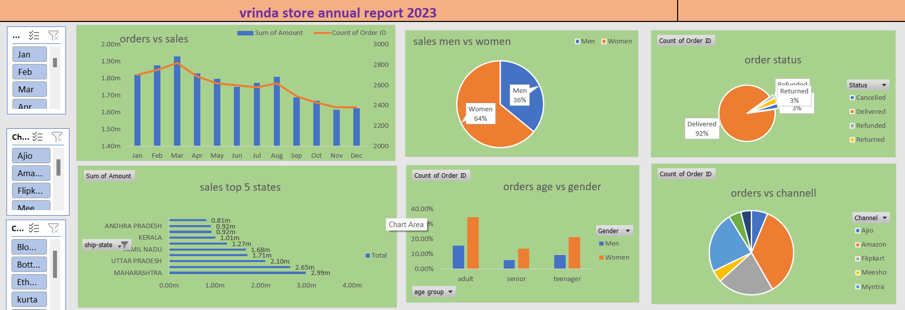
Final dashboard

Slide 25
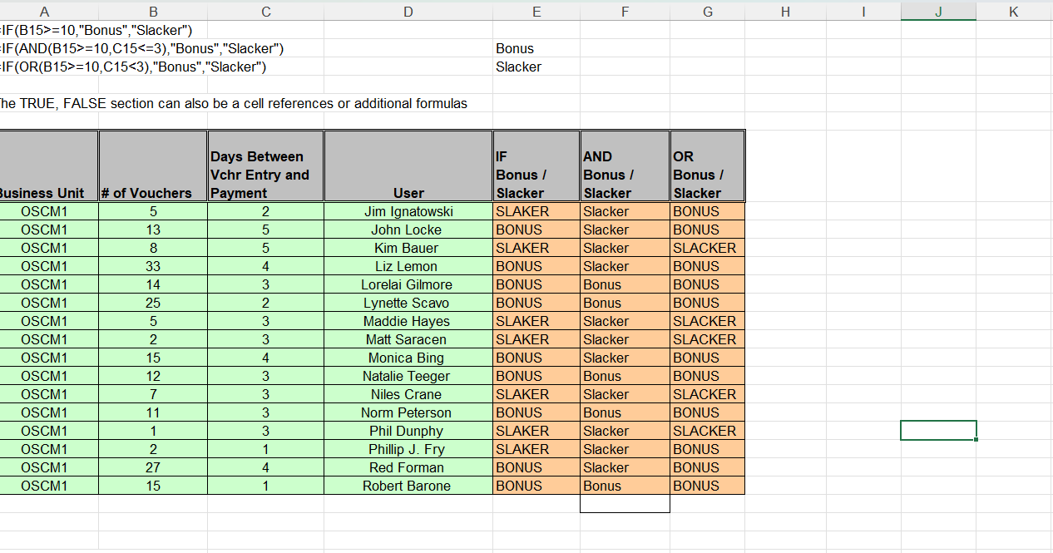
If and or in excel

Slide 26
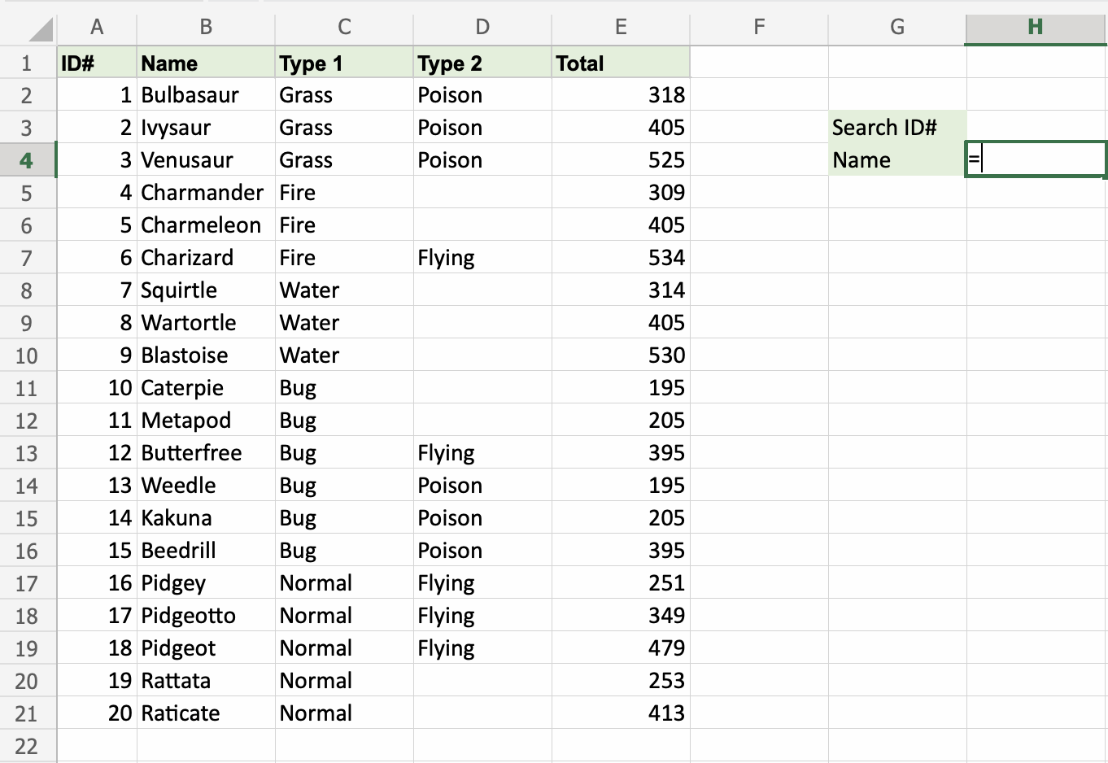
sum

Slide 27
Thank you for your attention and time

